Slide 1
Springs
Involves the spring constant, k
Hooke’s Law gives the force
  F = - k x
    F is the restoring force
    F is in the opposite direction of x
    k depends on how the spring was formed, the material it is made from, thickness of the wire, etc.
    The force is conservative for “ideal” springs, so there is an associated PE function

Slide 2
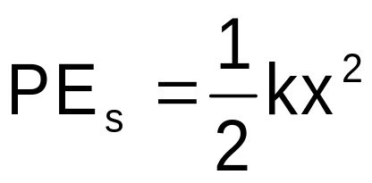
Spring Potential Energy
Elastic Potential Energy
  related to the work required to compress a spring from its equilibrium position to some final, arbitrary, position x

Slide 3
Work-Energy Theorem Including a Spring
W_{nc} = (KE_{f} – KE_{i}) + (PE_{gf} – PE_{gi}) + (PE_{sf} – PE_{si})
  PE_{g} is the gravitational potential energy
  PE_{s} is the elastic potential energy associated with a spring

Slide 4
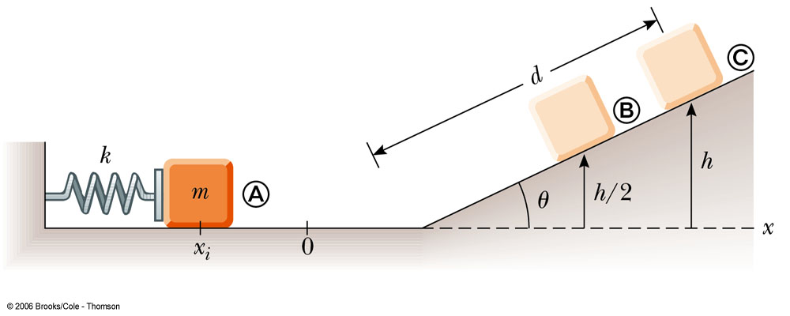
Classic Spring Problem
A block has mass m = 0.500 kg. The spring has k = 625 N/m and is compressed 10 cm.
  Find the distance d traveled if θ = 30º.
  How fast is the block moving at halfway up?

Slide 5

Nonconservative Forces with Energy Considerations
When nonconservative forces are present, the total mechanical energy of the system is not constant
The work done by all nonconservative forces acting on parts of a system equals the change in the mechanical energy of the system

Slide 6
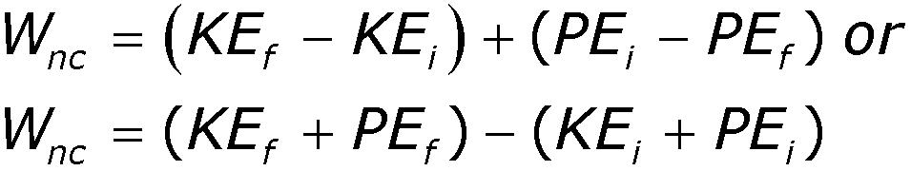
Nonconservative Forces and Energy
In equation form:
The energy can either cross a boundary or the energy is transformed into a form of non-mechanical energy such as thermal energy (so the total energy is still conserved, just not the sum of KE and PE)

Slide 7
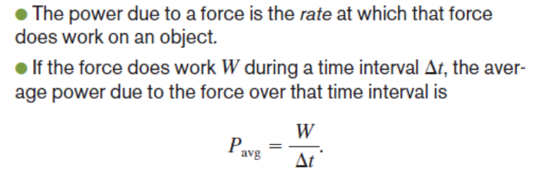
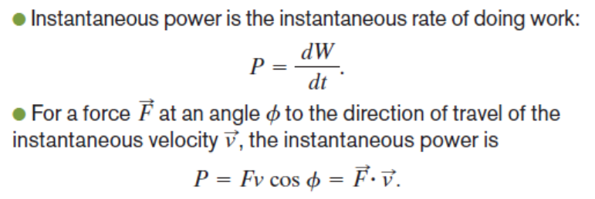
Power - Energy Transfer

Slide 8
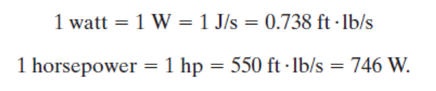
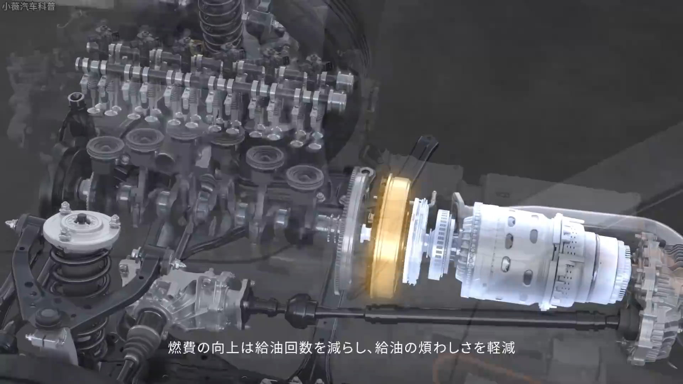

Slide 9
Center of Mass
The point in the body at which all the mass may be considered to be concentrated
  When using mechanical energy, the change in potential energy is related to the change in height of the center of mass

Slide 10
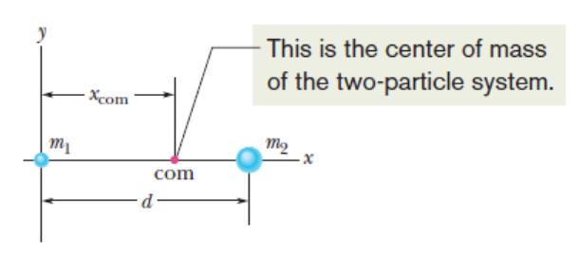

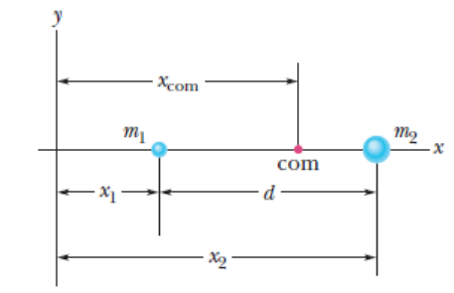

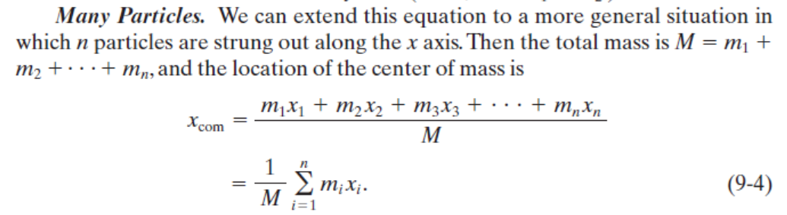

Slide 11
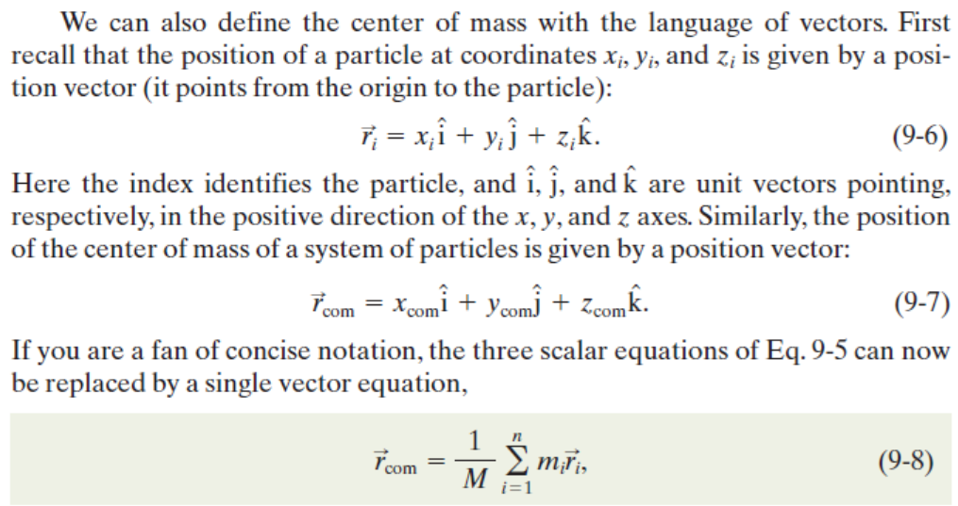

Slide 12
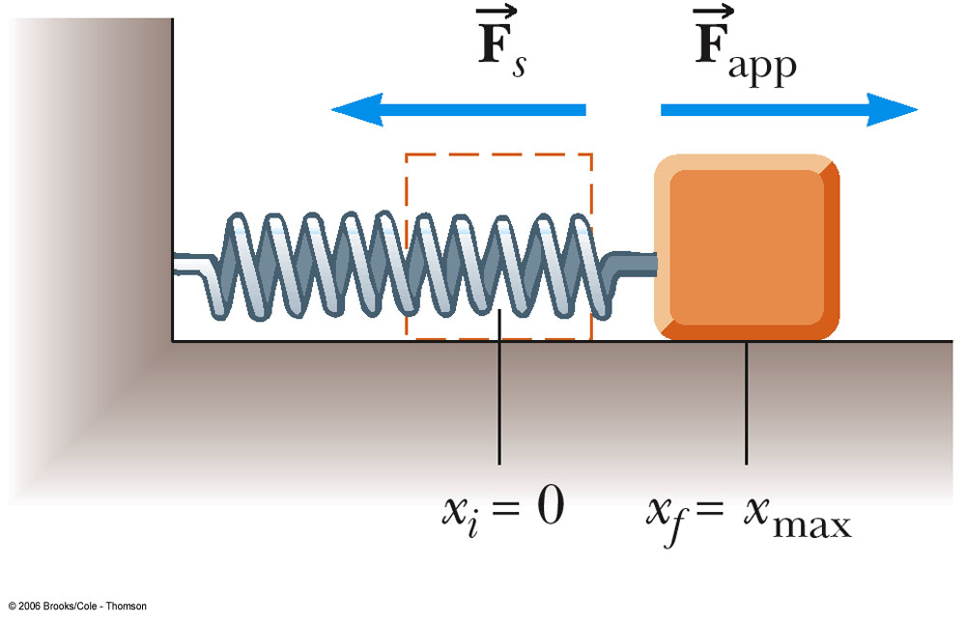
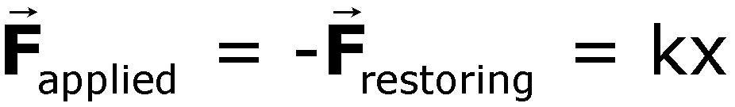
Recall Spring Example
Spring is slowly stretched from 0 to x_{max}
W = 1/2 kx²

Slide 13
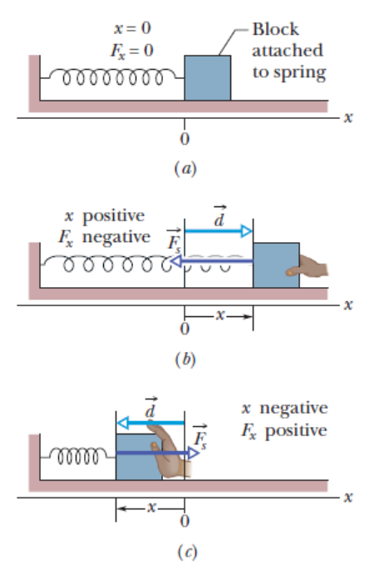
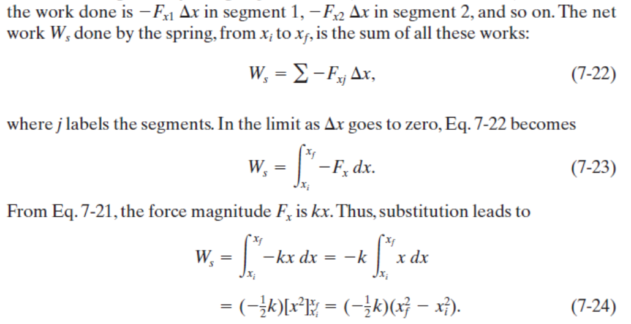
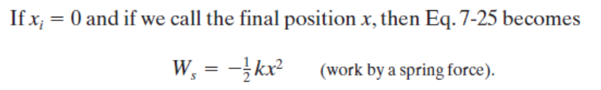
sum
integration

Slide 14
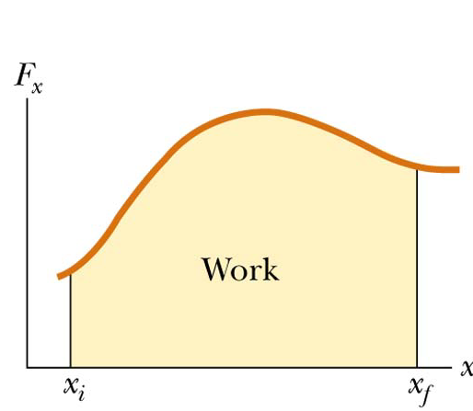
Work Done by Varying Forces
The work done by a variable force acting on an object that undergoes a displacement is equal to the area under the graph of F versus x
integration

Slide 15
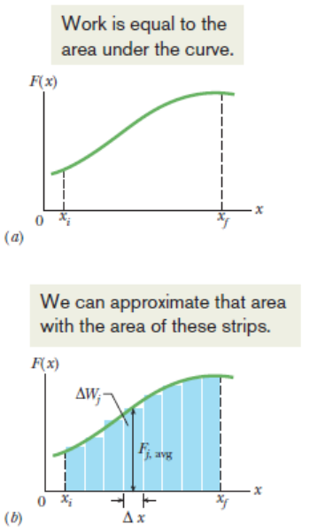


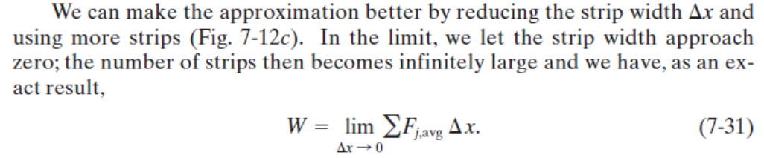
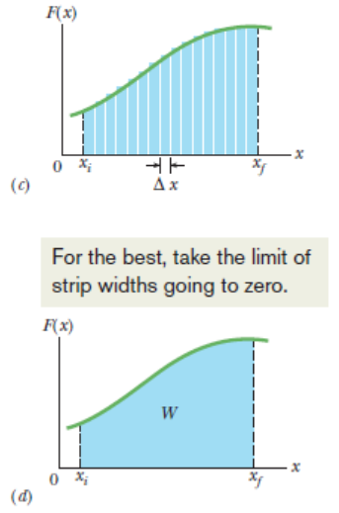
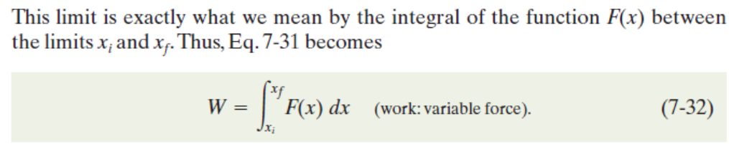
sum
sum
integration

Slide 16
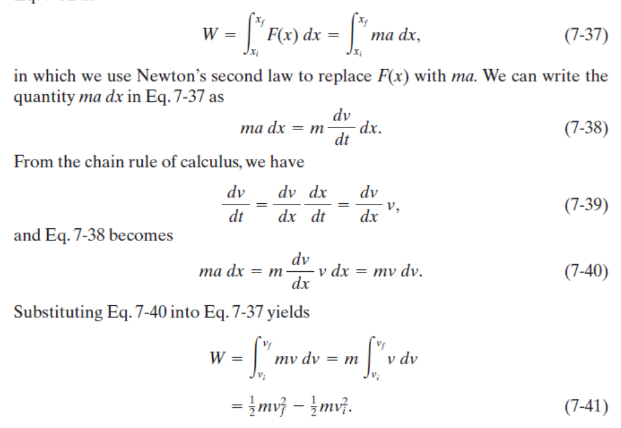

Slide 17
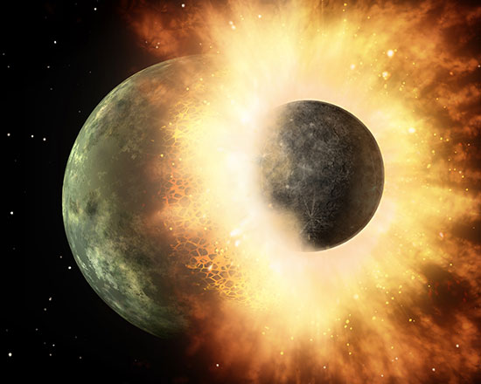
Chapter 6
Momentum and Collisions

Slide 18
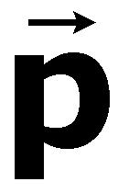
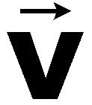
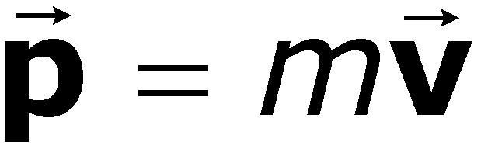
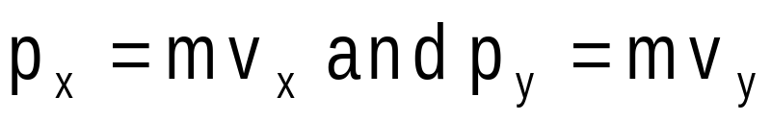
Momentum
The linear momentum of an object of mass m moving with a velocity is defined as the product of the mass and the velocity
  SI Units are kg m / s
  Vector quantity: the direction of the momentum is same as velocity’s

Slide 19
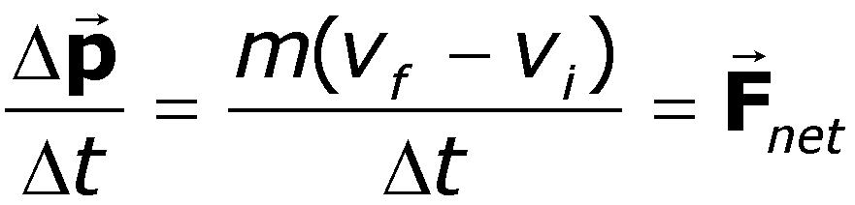
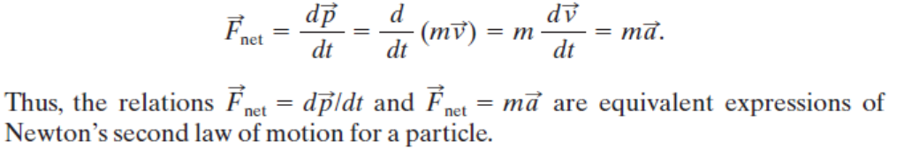
Momentum and Force
In order to change the momentum of an object, a force must be applied
The time rate of change of momentum of an object is equal to the net force acting on it
  Gives an alternative statement of Newton’s second law

Slide 20
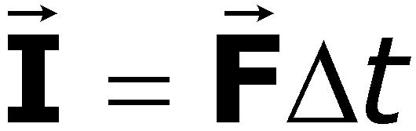

Impulse
When a single, constant force acts on the object, there is an impulse delivered to the object
  is defined as the impulse
  Vector quantity, the direction is the same as the direction of the force

Slide 21

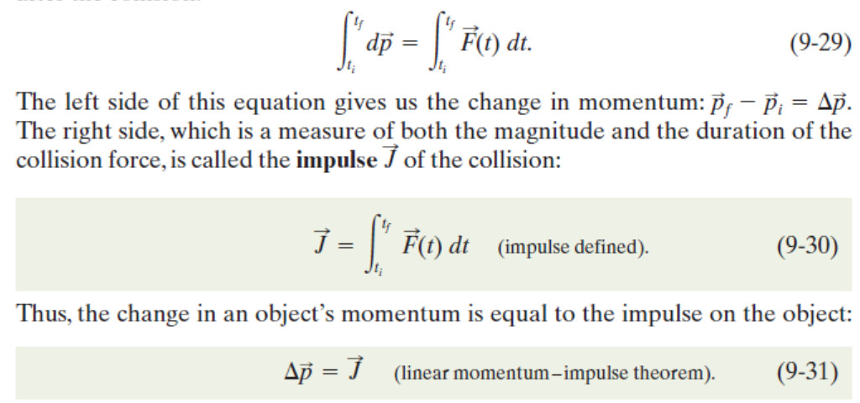

Slide 22
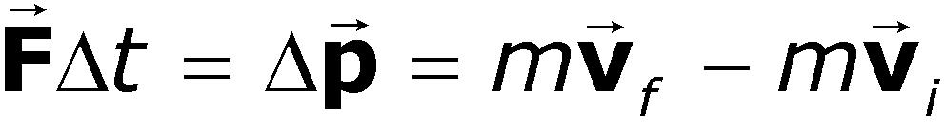
Impulse-Momentum Theorem
The theorem states that the impulse acting on the object is equal to the change in momentum of the object
  If the force is not constant, use the average force applied

Slide 23
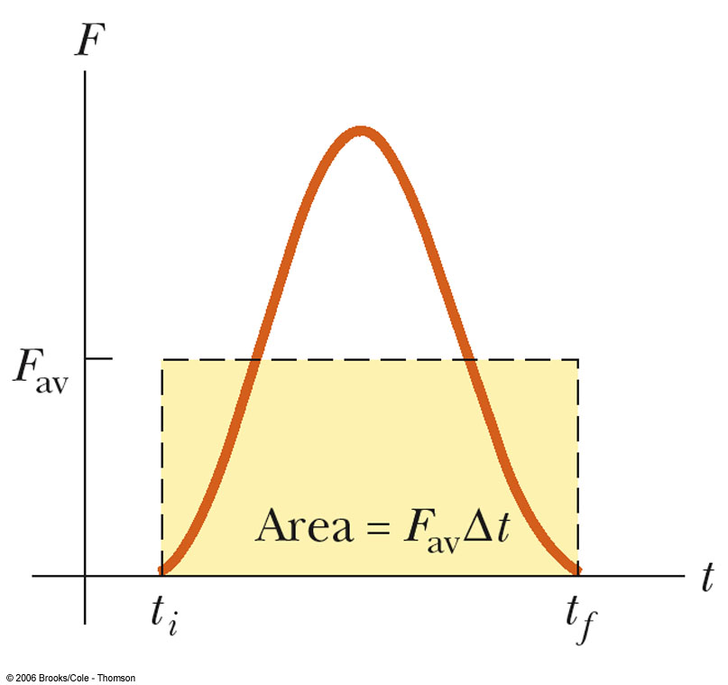
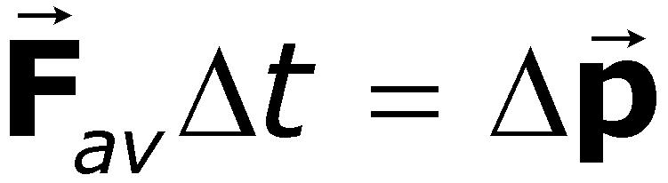
Average Force in Impulse
question
The average force can be thought of as the constant force that would give the same impulse to the object in the time interval as the actual time-varying force gives in the interval

Slide 24
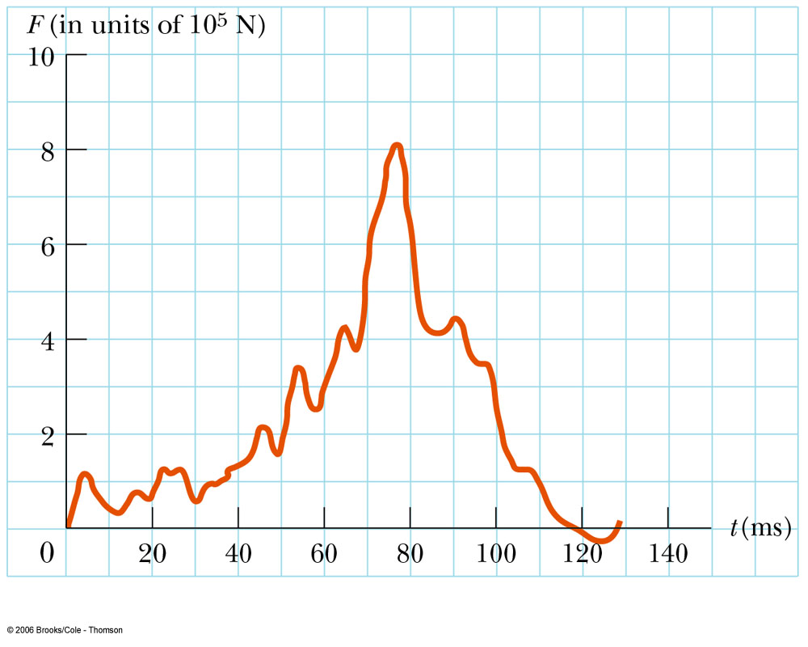
Impulse Applied to Auto Collisions
The most important factor is the collision time or the time it takes the person to come to a rest
  This will reduce the chance of dying in a car crash
Ways to increase the time
  Seat belts
  Air bags
Force on a car
for a typical collison

Slide 25
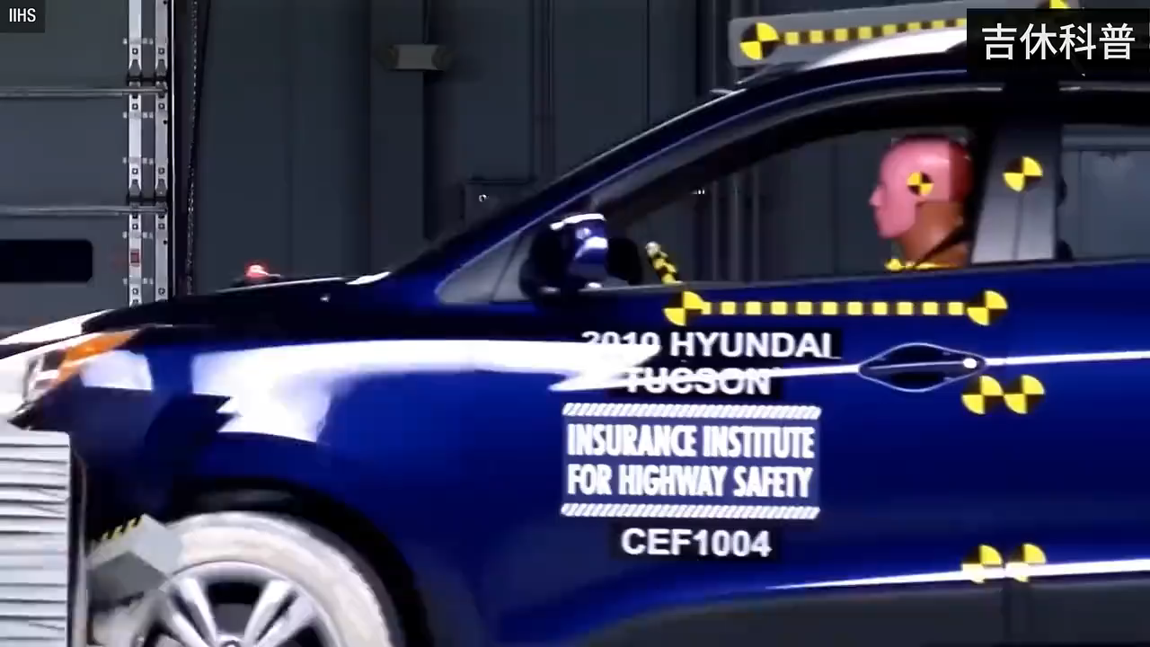


Slide 26
Momentum Conservation
Mathematically:
  Momentum is conserved for the system of objects
  The system includes all the objects interacting with each other
  Can be generalized to any number of objects

Slide 27
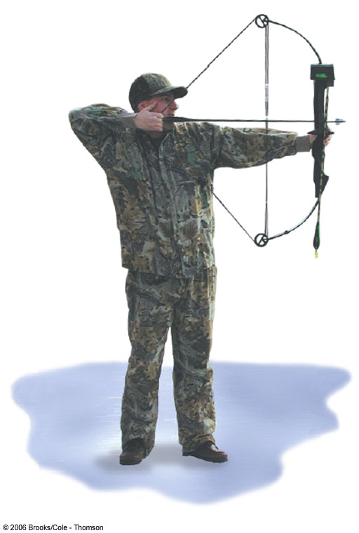
Example
An archer stands on frictionless ice. He fires an arrow of
m = 0.500 kg with
v_{x} = 50.0 m/s. The archer and bow have mass M = 60.0 kg.
Determine the recoil speed of the archer.

Slide 28
Types of Collisions
Momentum is always conserved
Inelastic collisions
  Kinetic energy is not conserved
    Some kinetic energy converted to other energy such as heat, sound, work to permanently deform an object
  Perfectly inelastic collisions occur when the objects stick together
Elastic collisions
  both momentum and kinetic energy are conserved

Slide 29
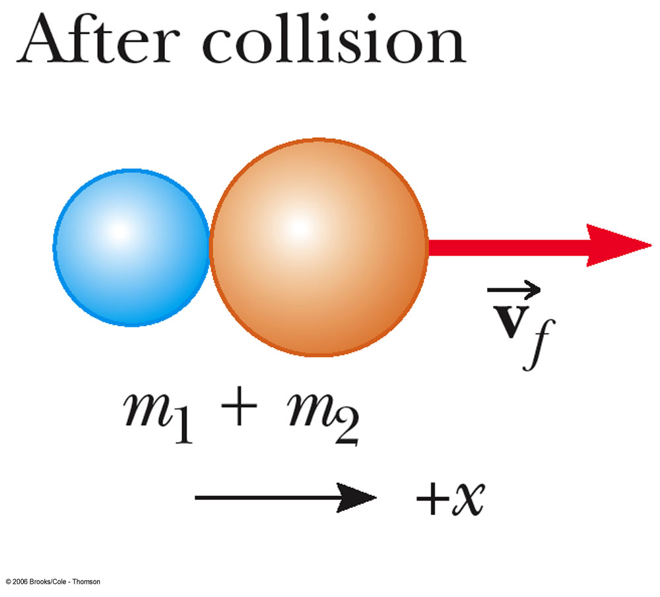
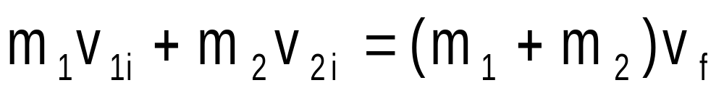
More About Perfectly Inelastic Collisions
When two objects stick together after the collision, they have undergone a perfectly inelastic collision
Conservation of momentum becomes

Slide 30
Quick Quiz
An object of mass m moves right with speed v. It collides head-on with an object of mass 3m moving left with speed v/3. If the two stick together to have mass 4m, what is the speed of the combined object?
  0
  v/2
  v
  2v

Slide 31
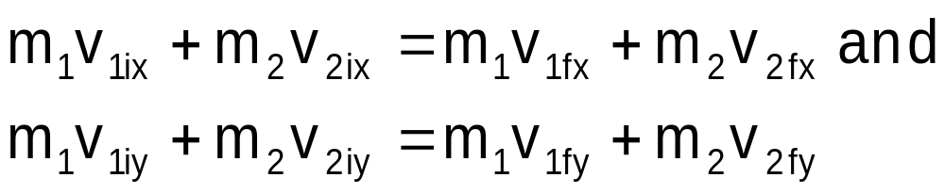
Glancing Collisions
For a general collision of two objects in two-dimensional space, the conservation of momentum principle implies that the total momentum of the system in each direction is conserved
  Use subscripts for identifying the object, initial and final velocities, and components

Slide 32
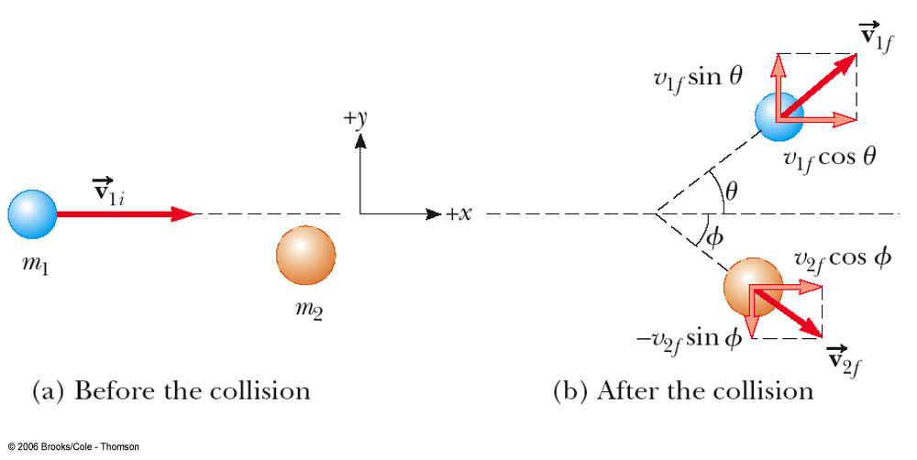
Glancing Collisions
The “after” velocities have x and y components
Momentum is conserved in the x direction and in the y direction
Apply conservation of momentum separately to each direction

Slide 33
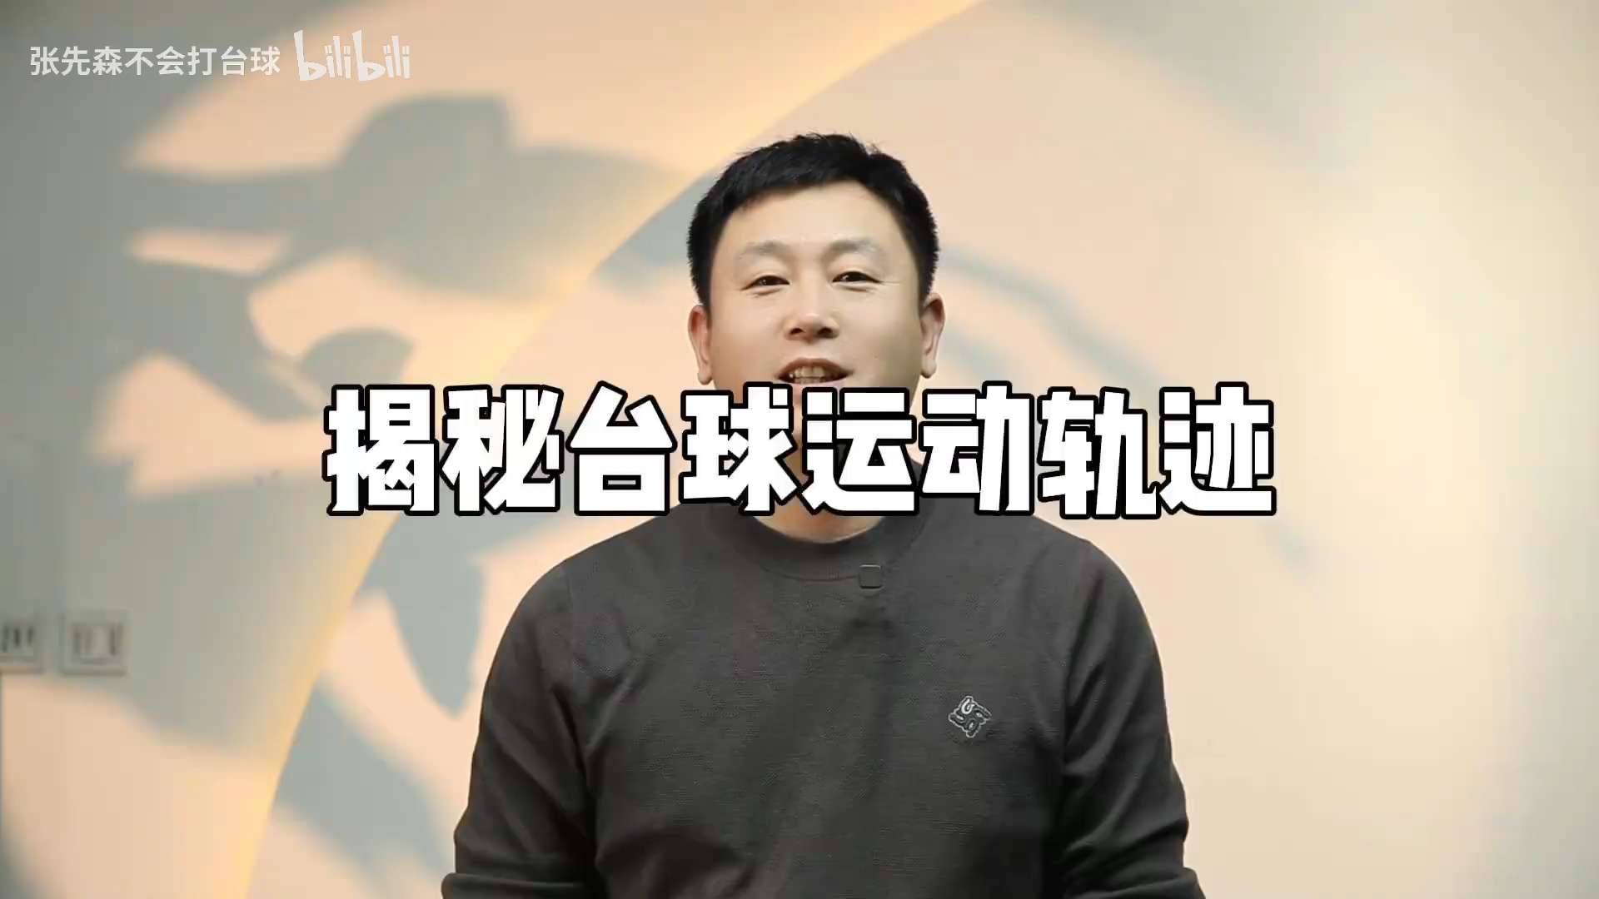

Slide 34
Problem #42
An 8.00 kg object moving east at 15.0 m/s on a frictionless horizontal surface collides with a 10.0 kg object at rest. After the collision, the 1st object moves South at 4.00 m/s.
  Find the velocity of the 2nd object.
  What percentage of the initial kinetic energy is lost in the collision?

Slide 35
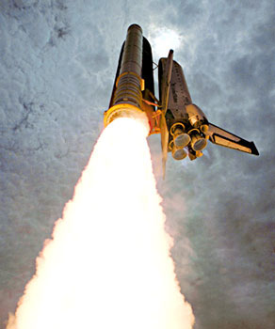
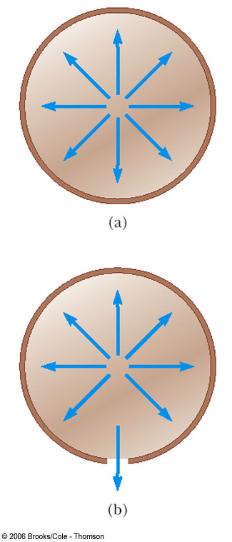
Rocket Propulsion
The rocket is accelerated as a result of the thrust of the exhaust gases
This represents the inverse of an inelastic collision
  Momentum is conserved
  Kinetic Energy is increased (at the expense of the stored energy of the rocket fuel)

Slide 36
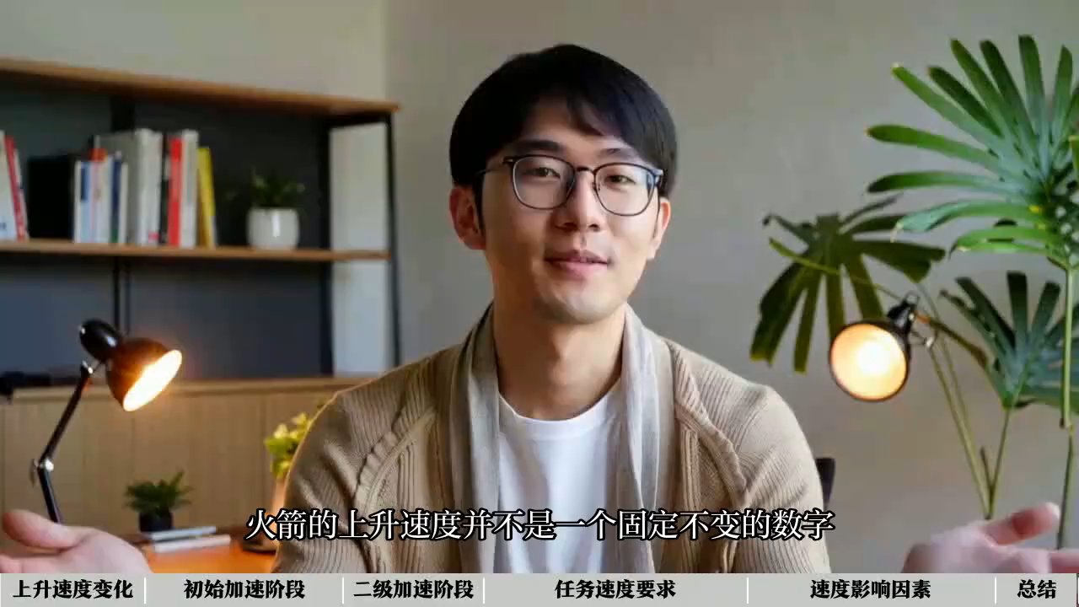

Slide 37
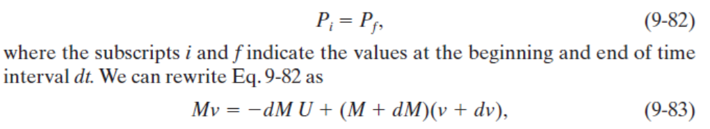
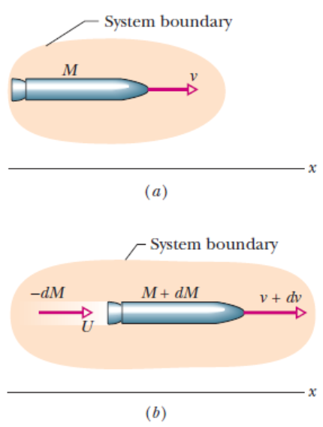
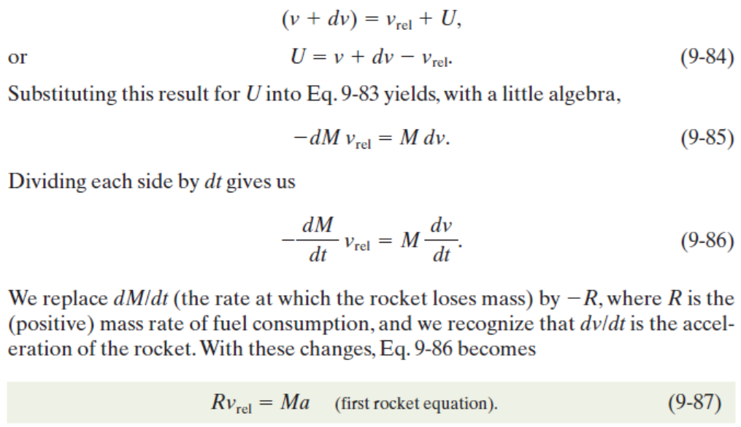

Slide 38
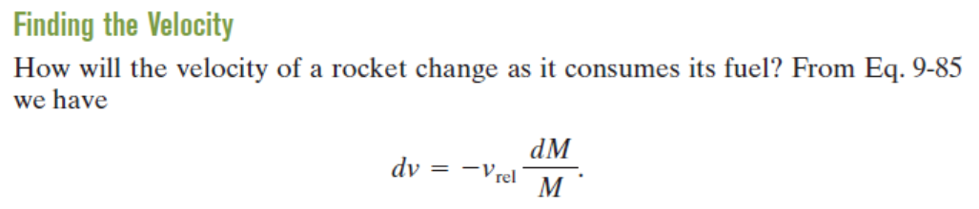
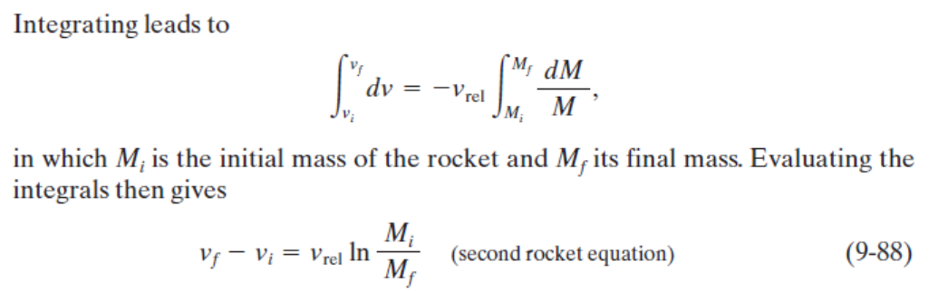

Slide 39

Chapter 7
Rotational Motion
and
The Law of Gravity

Slide 40



The Radian
The radian is a unit of angular measure
The radian can be defined as the arc length s along a circle divided by the radius r

Slide 41


More About Radians
Comparing degrees and radians
Converting from degrees to radians

Slide 42

Angular Displacement
Axis of rotation is the center of the disk
Need a fixed reference line
During time t, the reference line moves through angle θ

Slide 43
Example
A helicopter rotor turns at 320 revs/min. How fast is that in radians per second?

Slide 44
Rigid Body
Every point on the object undergoes circular motion about the point O
All parts of the object of the body rotate through the same angle during the same time
The object is considered to be a rigid body
  This means that each part of the body is fixed in position relative to all other parts of the body

Slide 45


Average Angular Speed
The average angular speed, ω, of a rotating rigid object is the ratio of the angular displacement to the time interval

Slide 46

Average Angular Acceleration
For a rigid body, every point has the same angular
speed and angular acceleration.

Slide 47


Analogies Between Linear and Rotational Motion

Slide 48




Relationship Between Angular and Linear Quantities
Displacements
Speeds
Accelerations
Every point on the rotating object has the same angular motion
Every point on the rotating object does not have the same linear motion

Slide 49

Centripetal Acceleration
Centripetal refers to “center-seeking”
The direction of the velocity changes
The acceleration is directed toward the center of the circle of motion

Slide 50

Centripetal Acceleration
The magnitude of the centripetal acceleration is given by
  This direction is toward the center of the circle

Slide 51

Centripetal Acceleration and Angular Velocity
The angular velocity and the linear velocity are related (v = ωr)
The centripetal acceleration can also be related to the angular velocity

Slide 52

Total Acceleration
The tangential component of the acceleration is due to changing speed
The centripetal component of the acceleration is due to changing direction
Total acceleration can be found from these components

Slide 53

Example
A race car accelerates uniformly from a speed of 40.0 m/s to 60.0 m/s in 5.00 s around a circular track of radius 400 m. When the car reaches a speed of 50.0 m/s find the
  Centripetal acceleration,
  Angular speed,
  Tangential acceleration,
  And the magnitude of the total acceleration.
v = ωr

Slide 54

Vector Nature of Angular Quantities
Angular displacement, velocity and acceleration are all vector quantities
Direction can be more completely defined by using the right hand rule
  Grasp the axis of rotation with your right hand
  Wrap your fingers in the direction of rotation
  Your thumb points in the direction of ω

Slide 55

Velocity Directions
In (a), the disk rotates clockwise, the velocity is into the page
In (b), the disk rotates counterclockwise, the velocity is out of the page

Slide 56
Acceleration Directions
If the angular acceleration and the angular velocity are in the same direction, the angular speed will increase with time
If the angular acceleration and the angular velocity are in opposite directions, the angular speed will decrease with time

Slide 57
Forces Causing Centripetal Acceleration
Newton’s Second Law says that the centripetal acceleration is accompanied by a force
  F_{C} = ma_{C}
  F_{C} stands for any force that keeps an object following a circular path
    Tension in a string
    Gravity
    Force of friction

Slide 58



Level Curves
Friction is the force that produces the centripetal acceleration
Can find the frictional force, µ, or v
v = ωr
  F_{C} = ma_{C}

Slide 59



Banked Curves
A component of the normal force adds to the frictional force to allow higher speeds
In this example circular motion sustained without friction:
v = ωr
  F_{C} = ma_{C}

Slide 60


Vertical Circle
Look at the forces at the top of the circle
The minimum speed at the top of the circle can be found
v = ωr
  mg = F_{C} = ma_{C}
mg = m(v²)/R

Slide 61
Forces in Accelerating Reference Frames
Distinguish real forces from fictitious forces
“Centrifugal” force is a fictitious force
Real forces always represent interactions between objects

Slide 62

Newton’s Law of Universal Gravitation
Every particle in the Universe attracts every other particle with a force that is directly proportional to the product of the masses and inversely proportional to the square of the distance between them.

Slide 63
Gravity Notes
G is the constant of universal gravitational
G = 6.673 x 10⁻¹¹ N m² /kg²
This is an example of an inverse square law

Slide 64

Gravity and the 3rd Law
The force that mass 1 exerts on mass 2 is equal and opposite to the force mass 2 exerts on mass 1
The forces form a Newton’s third law action-reaction

Slide 65



Gravitation Constant
Determined experimentally
Henry Cavendish
  1798
The light beam and mirror serve to amplify the motion

Slide 66


Slide 67

Example
The three billiard balls all have the same mass of 0.300 kg. Determine the force components due to gravity acting on each ball.

Slide 68


Applications of Universal Gravitation
Acceleration due to gravity
g will vary with altitude

Slide 69


Gravitational Potential
Energy
PE = mgy is valid only near the earth’s surface
For objects high above the earth’s surface, an alternate expression is needed
  Zero reference level is infinitely far from the earth

Slide 70

Escape Speed
The escape speed is the speed needed for an object to soar off into space and never return
For the earth, v_{esc} is about 11.2 km/s
Note, v is independent of the mass of the object

Slide 71


Slide 72








First cosmic velocity
Second cosmic velocity

Slide 73

Various Escape Speeds
The escape speeds for various members of the solar system
Escape speed is one factor that determines a planet’s atmosphere

Slide 74
Kepler’s Laws
All planets move in elliptical orbits with the Sun at one of the focal points.
A line drawn from the Sun to any planet sweeps out equal areas in equal time intervals.
The square of the orbital period of any planet is proportional to cube of the average distance from the Sun to the planet.

Slide 75


Slide 76

Kepler’s First Law
All planets move in elliptical orbits with the Sun at one focus.
  Any object bound to another by an inverse square law will move in an elliptical path
  Second focus is empty

Slide 77

Kepler’s Second Law
A line drawn from the Sun to any planet will sweep out equal areas in equal times
  Area from A to B and C to D are the same

Slide 78

Kepler’s Third Law
The square of the orbital period of any planet is proportional to cube of the average distance from the Sun to the planet.
  For orbit around the Sun, K = K_{S} = 2.97x10⁻¹⁹ s²/m³
  K is independent of the mass of the planet

Slide 79
Communications Satellite
A geosynchronous orbit
  Remains above the same place on the earth
  The period of the satellite will be 24 hr
r = h + R_{E}
Still independent of the mass of the satellite

Slide 80
Chapter 8
Rotational Equilibrium
and
Rotational Dynamics

Slide 81

Torque
The door is free to rotate about an axis through O
There are three factors that determine the effectiveness of the force in opening the door:
  The magnitude of the force
  The position of the application of the force
  The angle at which the force is applied

Slide 82
Torque, cont
Torque, τ, is the tendency of a force to rotate an object about some axis
  τ = r F
    τ is the torque
    F is the force
      symbol is the Greek tau
    r is the length of the position vector
SI unit is N.m

Slide 83

Right Hand Rule
Point the fingers in the direction of the position vector
Curl the fingers toward the force vector
The thumb points in the direction of the torque

Slide 84


General Definition of Torque
Taking the angle into account leads to a more general definition of torque:
  τ = r F sin θ
    F is the force
    r is the position vector
    θ is the angle between the force and the position vector

Slide 85

Lever Arm
The lever arm, d, is the perpendicular distance from the axis of rotation to a line drawn along the direction of the force
d = r sin θ

Slide 86

Example
A man applies a force as shown. Find the torque on the door relative to the hinges.
Suppose a wedge is placed 1.50 m from the hinges. What force must the wedge exert so that the door will not open.

Slide 87

Translational Equilibrium
First Condition of Equilibrium
    The net external force must be zero
  This is a necessary, but not sufficient, condition to ensure that an object is in complete mechanical equilibrium
  This is a statement of translational equilibrium

Slide 88

Rotational Equilibrium
To ensure mechanical equilibrium, you need to ensure rotational equilibrium as well as translational
The Second Condition of Equilibrium states
  The net external torque must be zero

Slide 89

Equilibrium Example
The woman, mass m, sits on the left end of the see-saw
The man, mass M, sits where the see-saw will be balanced
Apply the Second Condition of Equilibrium and solve for the unknown distance, x

Slide 90
Center of Gravity
The force of gravity acting on an object must be considered
In finding the torque produced by the force of gravity, all of the weight of the object can be considered to be concentrated at a single point, the center of gravity

Slide 91

Calculating the Center of Gravity
The object is divided up into a large number of very small particles of weight (m_{i}g)
Each particle will have a set of coordinates indicating its location (x,y)

Slide 92

Calculating the Center of Gravity, cont.
The center of gravity is the location where the body acts as if all its mass were located at that point.
The coordinates of the center of gravity can be found from the sum of the torques acting on the individual particles being set equal to the torque produced by the weight of the object

Slide 93
Center of Gravity of a Uniform Object
The center of gravity of a homogenous, symmetric body must lie on the axis of symmetry.
Often, the center of gravity of such an object is the geometric center of the object.

Slide 94

Find your center of gravity
Consider a person with L = 173 cm and weight w = 715 N. Laying on a board with weight w_{b} = 49 N, a scale has a force reading of F = 350 N. Find the person’s center of gravity.

Slide 95

Experimentally Determining the Center of Gravity
The wrench is hung freely from two different pivots
The intersection of the lines indicates the center of gravity
A rigid object can be balanced by a single force equal in magnitude to its weight as long as the force is acting upward through the object’s center of gravity

Slide 96

Example of a Free Body Diagram (Forearm)
Isolate the object to be analyzed
Draw the free body diagram for that object
  Include all the external forces acting on the object

Slide 97

Example of a Free Body Diagram (Ladder)
The free body diagram shows the normal force and the force of static friction acting on the ladder at the ground
The last diagram shows the lever arms for the forces

Slide 98



Torque and Angular Acceleration
When a rigid object is subject to a net torque (≠0), it undergoes an angular acceleration
The angular acceleration is directly proportional to the net torque
  The relationship is analogous to ∑F = ma

Slide 99
Moment of Inertia
The angular acceleration is inversely proportional to the analogy of the mass in a rotating system
This mass analog is called the moment of inertia, I, of the object
  SI units are kg m²

Slide 100
Newton’s Second Law for a Rotating Object
The angular acceleration is directly proportional to the net torque
The angular acceleration is inversely proportional to the moment of inertia of the object

Slide 101
More About Moment of Inertia
There is a major difference between moment of inertia and mass: the moment of inertia depends on the quantity of matter and its distribution in the rigid object.
The moment of inertia also depends upon the location of the axis of rotation

Slide 102






Moment of Inertia of a Uniform Ring
The two rigid objects below have the same mass, radius, and angular speed. If the same braking torque is applied to each, which will take longer to stop? A, B, or not enough info?
›

Slide 103


Moment of Inertia of a Uniform Ring
Imagine the hoop is divided into a number of small segments, m₁ …
These segments are equidistant from the axis

Slide 104

Other Moments of Inertia

Slide 105
Rotational Kinetic Energy
An object rotating about some axis with an angular speed, ω, has rotational kinetic energy 1/2 Iω²
Energy concepts can be useful for simplifying the analysis of rotational motion

Slide 106
Total Energy of a System
Conservation of Mechanical Energy
  Remember, this is for conservative forces, no dissipative forces such as friction can be present
  Potential energies of any other conservative forces could be added

Slide 107
Work-Energy in a Rotating System
In the case where there are dissipative forces such as friction, use the generalized Work-Energy Theorem instead of Conservation of Energy
W_{nc} = ΔKE_{t} + ΔKE_{R} + ΔPE

Slide 108


Angular Momentum
Similar to the relationship between force and momentum in a linear system, we can show the relationship between torque and angular momentum
Angular momentum is defined as
  L = I ω
  and

Slide 109

More Angular Momentum
If the net torque is zero, the angular momentum remains constant
Conservation of Angular Momentum states: The angular momentum of a system is conserved when the net external torque acting on the systems is zero.
  That is, when

Slide 110

Conservation of Angular Momentum, Example
With hands and feet drawn closer to the body, the skater’s angular speed increases
  L is conserved, I decreases, ω increases

Slide 111


Slide 112


Slide 113


